Slide 1
Multiple Regression
Interactions … FLEXIBLE SLOPES!!!!

Slide 2

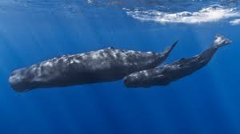
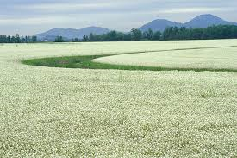
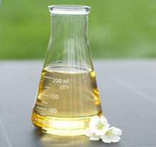
Case 1: Meadowfoam
Data from M. Seddigh and G. D. Jolliﬀ, “Light Intensity Eﬀects on
Meadowfoam Growth and Flowering,” Crop Science 34 (1994): 497–503.)

Slide 3
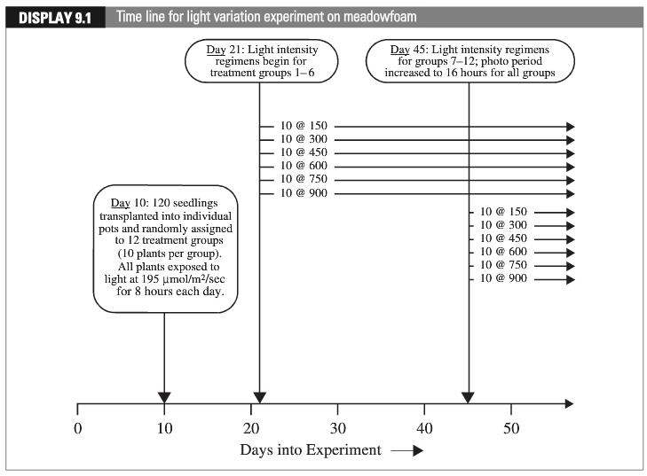
Case 1 Experimental Design: Meadowfoam
“Early”
“Late”
Data from M. Seddigh and G. D. Jolliﬀ, “Light Intensity Eﬀects on
Meadowfoam Growth and Flowering,” Crop Science 34 (1994): 497–503.)

Slide 4
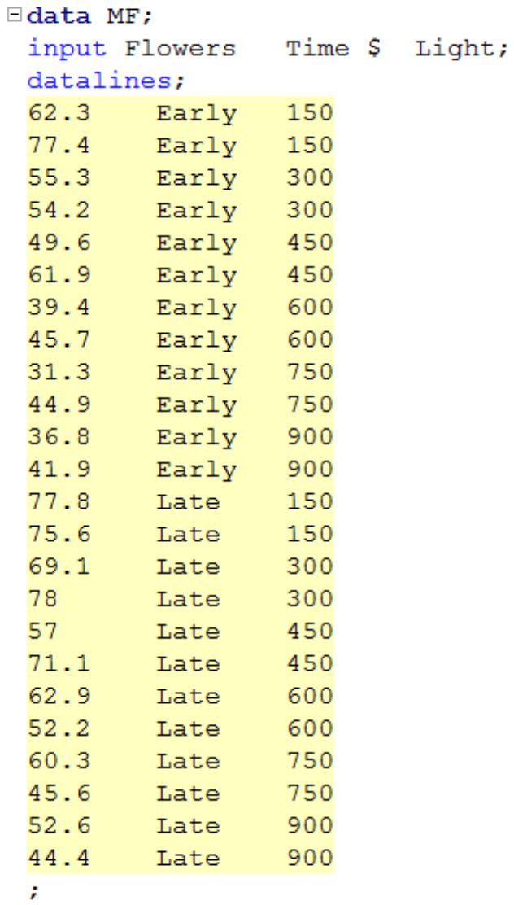
Meadowfoam: Data

Slide 5
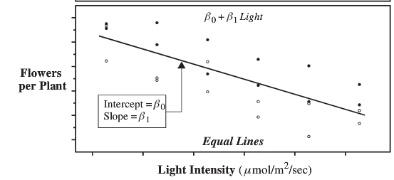
Equal Lines

Slide 6
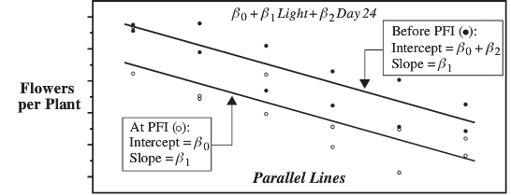
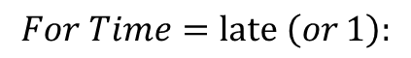
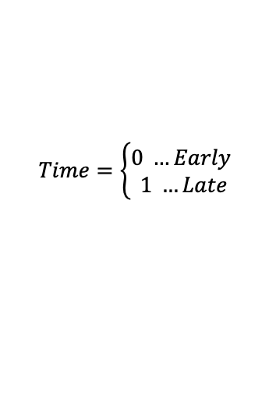

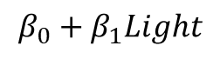
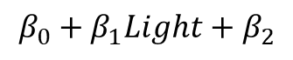
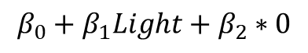
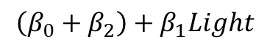
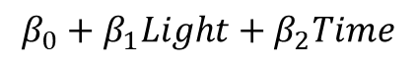
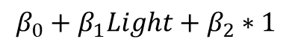
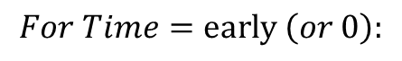
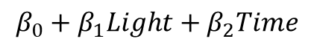
Parallel Lines: different intercepts, same slopes
$$Time=\left\{\begin{aligned}0 …Early \\ 1 …Late\end{aligned}\right.$$
$$β_{0}+β_{1}Light+β_{2}Time$$
Late
Early
$$For Time=\text{late} \left(or 1\right):$$
$$For Time=\text{early} \left(or 0\right):$$
$$β_{0}+β_{1}Light+β_{2}Time$$
$$β_{0}+β_{1}Light+β_{2}Time$$
0
$$β_{0}+β_{1}Light+β_{2}∗1$$
$$β_{0}+β_{1}Light+β_{2}∗0$$
$$β_{0}+β_{1}Light+β_{2}$$
$$β_{0}+β_{1}Light$$
$$\left(β_{0}+β_{2}\right)+β_{1}Light$$
slope
intercept

Slide 7
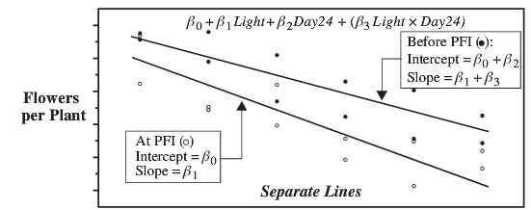
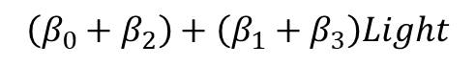
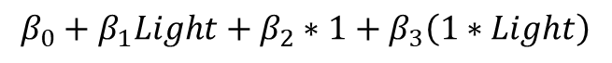
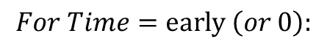
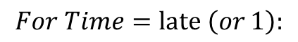
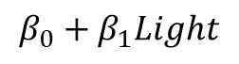
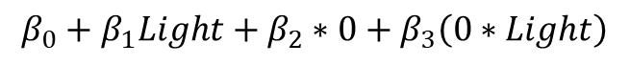
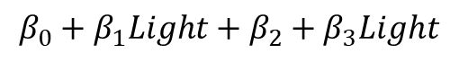
Nonparallel lines: different slopes (and intercepts)
Time is called an indicator variable:
Early = 0
Late = 1
$$β_{0}+β_{1}Light+β_{2}Time+β_{3}\left(Light x Time\right)$$
Late
Early
$$For Time=\text{late} \left(or 1\right):$$
$$For Time=\text{early} \left(or 0\right):$$
$$β_{0}+β_{1}Light+β_{2}Time+β_{3}\left(Time∗Light\right)$$
$$β_{0}+β_{1}Light+β_{2}Time+β_{3}\left(Time∗Light\right)$$
0
0
$$β_{0}+β_{1}Light+β_{2}∗1+β_{3}\left(1∗Light\right)$$
$$β_{0}+β_{1}Light+β_{2}∗0+β_{3}\left(0∗Light\right)$$
$$β_{0}+β_{1}Light+β_{2}+β_{3}Light$$
$$β_{0}+β_{1}Light$$
$$\left(β_{0}+β_{2}\right)+\left(β_{1}+β_{3}\right)Light$$
slope
intercept

Slide 8
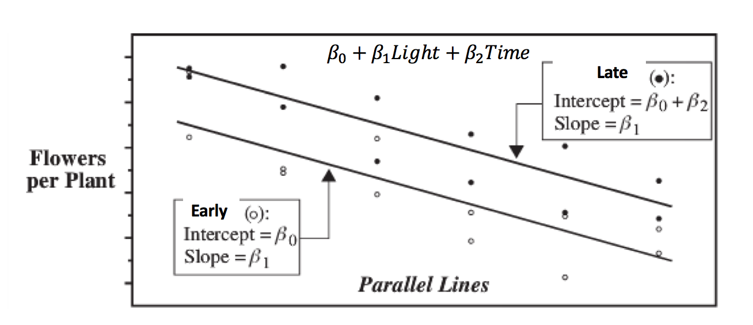
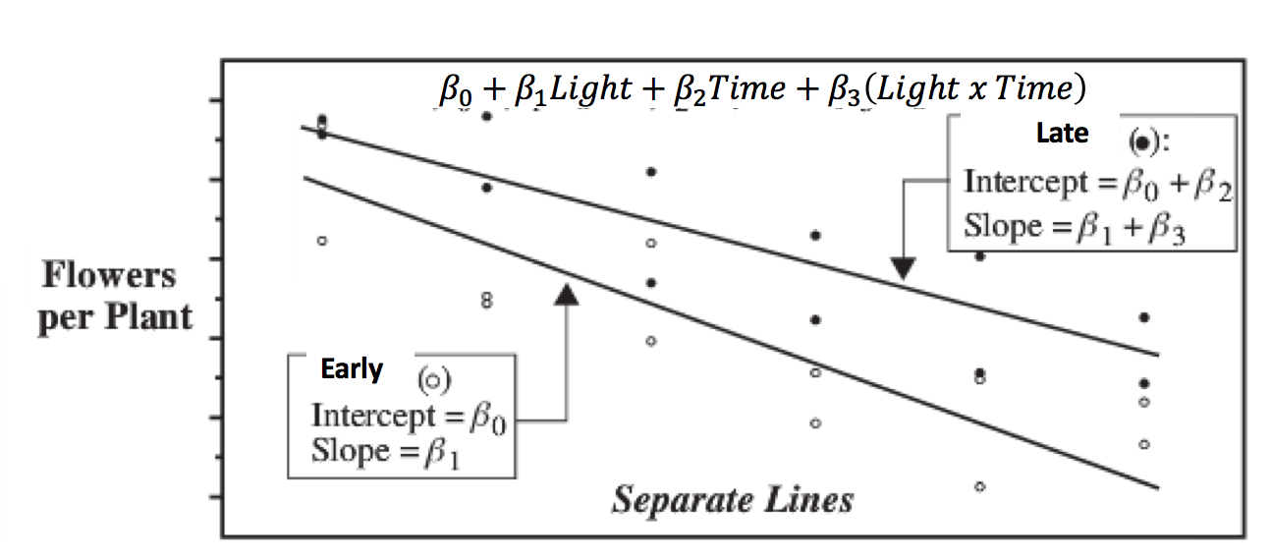
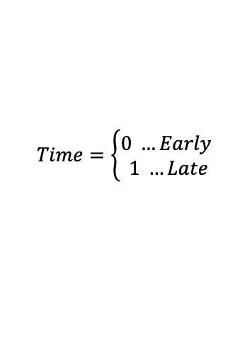
$$Time=\left\{\begin{aligned}0 …Early \\ 1 …Late\end{aligned}\right.$$
Simple Linear Regression
Time with No Interaction
Time with Interaction
Interaction means we can adjust the slope!!!

Slide 9

Interaction Terms! … (Flexible Slopes!)
$$μ\left\{flowers \right|light, time)= β_{0}+β_{1}Light+β_{2}Time+β_{3}\left(Light x Time\right)$$
$$μ\left\{flowers \right|light, time)= β_{0}+β_{2}Time+β_{1}Light+β_{3}\left(Light x Time\right)$$
Factor out Light and combine last two terms.
intercept
slope
$$μ\left\{flowers \right|light, time)=\left(β_{0}+{β_{2}Time)+(β}_{1}+β_{3}Time\right)Light$$
Now the intercept AND the slope depend on the time!

Slide 10
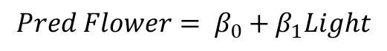
Is the separate slope model appropriate?
Construct a model in which the mean flower production depends linearly on the light intensity and the time category. Also allow for the possibility of unequal slopes and intercepts.
Which model is correct?
No possibility of unequal intercepts OR unequal slopes for different time categories.
$$Pred Flower= β_{0}+β_{1}Light$$
Possibility of unequal intercepts BUT NO possibility of unequal slopes for different time categories.
$$Pred Flower= β_{0}+β_{1}Light+ β_{2}Time$$
No possibility of unequal intercepts BUT has a possibility of unequal slopes for different time categories.
$$Pred Flower= β_{0}+β_{1}Light+β_{3}Light ∗ Time$$
Typically, we do NOT include an interaction term with out relevant single terms!!!
Possibility of both unequal intercepts or unequal slopes for different time categories.
$$Pred Flower= β_{0}+β_{1}Light+ β_{2}Time+ β_{3}Light ∗ Time$$

Slide 11
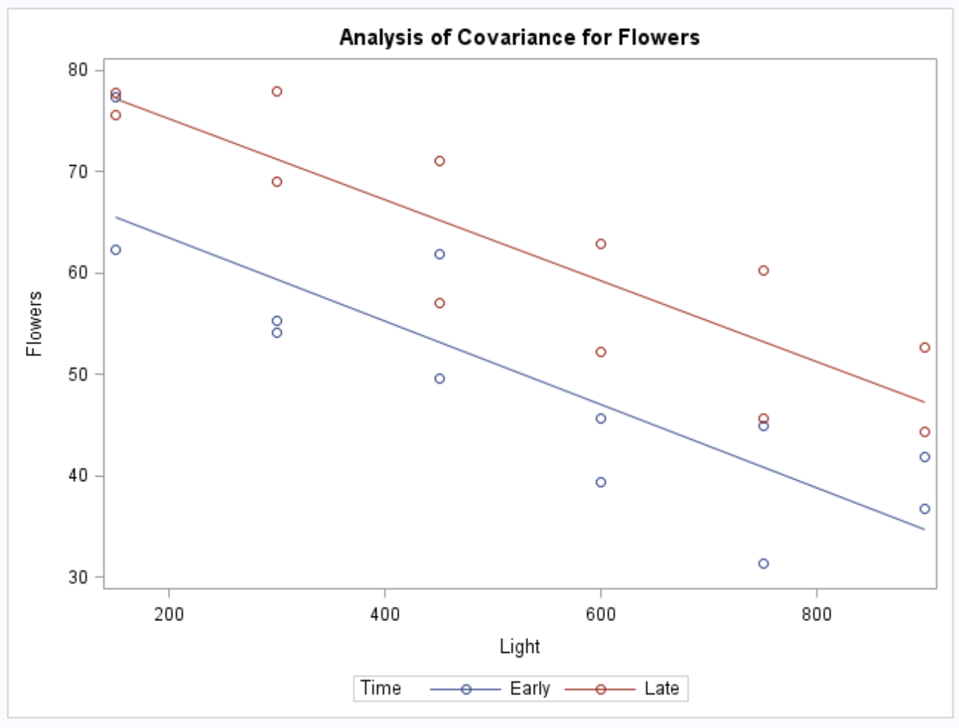
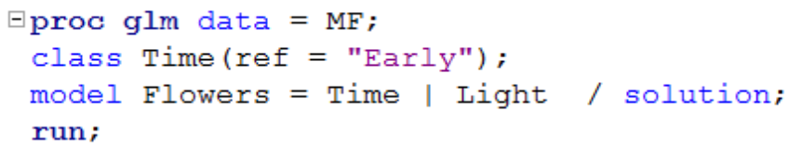
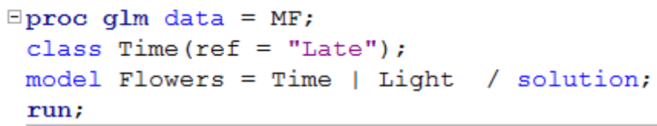
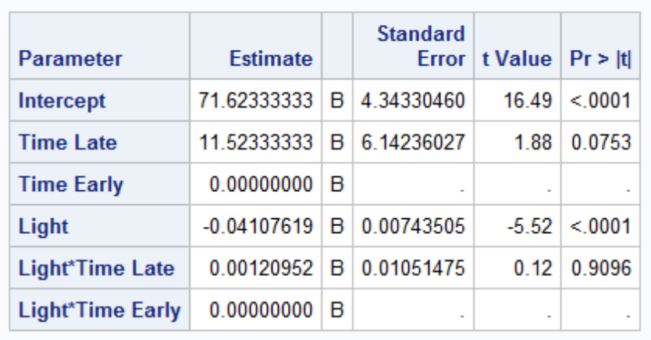
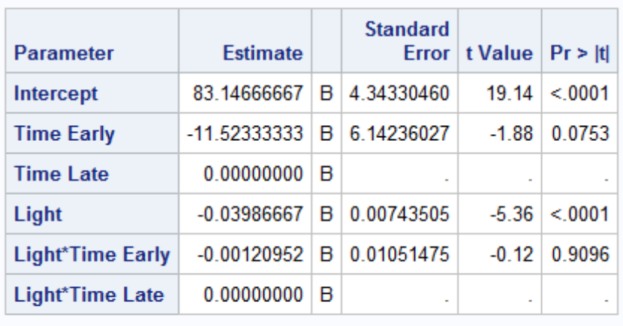
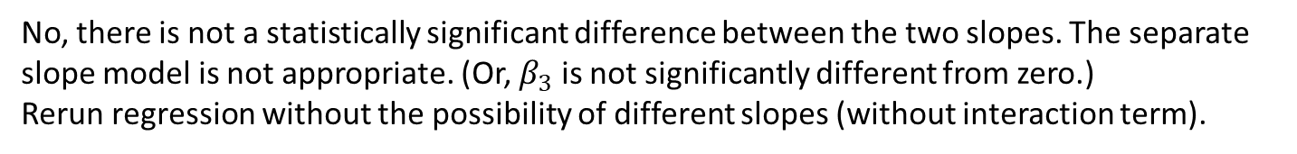
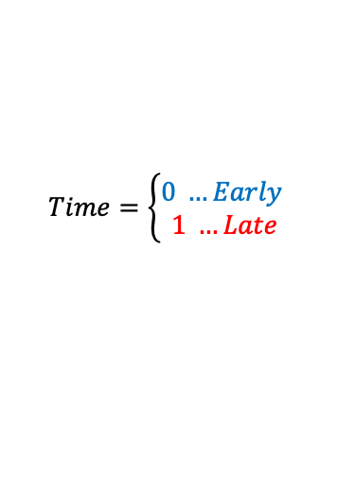
Is the separate slope model appropriate?
Construct a model in which the mean flower production depends linearly on the light intensity and the time category. Also allow for the possibility of unequal slopes and intercepts.
$$Pred Flower= β_{0}+β_{1}Light+ β_{2}Time+ β_{3}Light ∗ Time$$
$$Time=\left\{\begin{aligned}0 …Early \\ 1 …Late\end{aligned}\right.$$
No, there is not a statistically significant difference between the two slopes. The separate slope model is not appropriate. (Or, $β_{3}$ is not significantly different from zero.)
Rerun regression without the possibility of different slopes (without interaction term).

Slide 12
Question From FLS
Is there ANY benefit or reason to create separate regression models for each level like I did in my job interview where I had a linear reg for each pitch type (fastball, slider, curve, changeup, etc)?
Should we always avoid adding explanatory variables that correlate with one another? Could there be a benefit if we include them?
Is there a point when we would not add an explanatory variable to our MLR even if it improves the fit? for example, if the increase in fit is pretty small, would we rather exclude that variable?

Slide 13
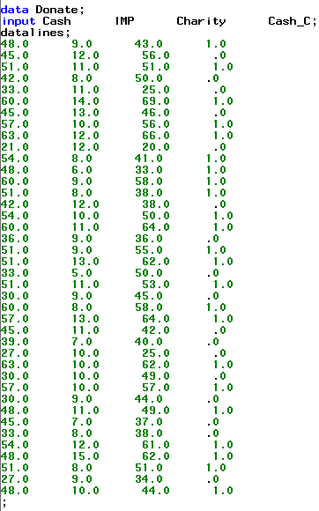
Example Where Interaction Matters
This is a data set that records the amount of cash someone makes (Cash in $1000s) and the amount of money he gives to Charity (Charity in $1s) based on the Importance (Imp) each subject attributes to charity. Cash_C is a variable that indicates if the person makes over $45,000.
Indicator variableCash_C:
0: <= $45,000
1: > $45,000

Slide 14
Example Where Interaction Matters
Construct a multiple linear regression model in which the mean charitable donation depends (linearly) on the importance of the charity and both income groups. Allow for possible different slopes and intercepts.
Charity in $s.
Cash in $1,000s.
Cash_C:
0: <= $45,000
1: > $45,000
$Predicted Charity= β_{0}+β_{1}Imp+ β_{2}Cash_{C}+ β_{3}Cash_{C}$*$Imp$

Slide 15
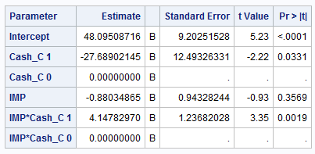
Breakout 1
Write two equations for the regression of Charity on Importance … one for each value of Cash_C.
Cash_C:
0: <= $45,000
1: > $45,000

Slide 16
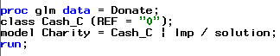
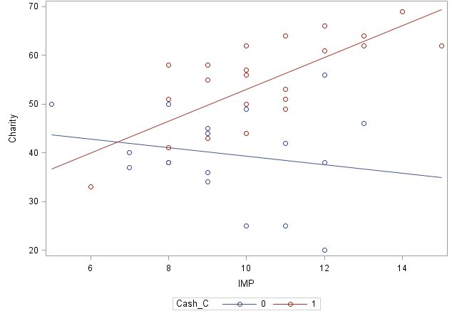
Fit the Model
Cash_C:
0: <= $45,000
1: > $45,000
Check the highest order terms first!
Include all lower order terms that are included in a significant interaction!
$Predicted Charity= β_{0}+β_{1}Imp+ β_{2}Cash_{C}+ β_{3}Cash_{C}$* $Imp$
Predicted Charity = 48.10 - .88 Imp - 27.68 Cash_{C} + 4.15 Cash_{C} * Imp

Slide 17
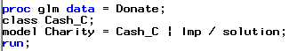
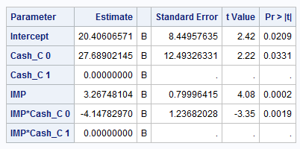
Charity, Cash (binary), and Perceived Importance
$$Pred Charity= β_{0}+β_{1}Imp+ β_{2}Cash_{C}+ β_{3}Cash_{C}∗Imp$$
Depending on which value is chosen as the reference (0 or 1), the betas will be different but the individual regression equations will be the same.
Remember to Include All Terms that are included in an interaction!

Slide 18

Fit the Model
Cash_C:
0: <= $45,000
1: > $45,000
Predicted Charity = 48.10 - .88 Imp - 27.68 Cash_{C} + 4.15 Cash_{C} *Imp
Predicted Charity = 48.10 - 27.68 Cash_{C} -.88 Imp + 4.15 Cash_{C} *Imp
Factor out Imp and combine last two terms.
intercept
slope
Predicted Charity = (48.10 - 27.68 Cash_{C}) +(-.88 + 4.15 Cash_{C}) Imp
For low income (Cash_C = 0):
0
0
predicted Charity = 48.10 -27.68*0+ (-0.88 +4.15*0) Importance
predicted Charity = 48.10 - 0.88 Importance
For high income (Cash_C = 1):
predicted Charity = 48.10 – 27.68*1+(-0.88 +4.15*1) Importance
predicted Charity = 20.42 + 3.27 Importance

Slide 19
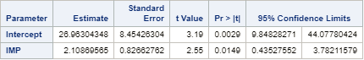
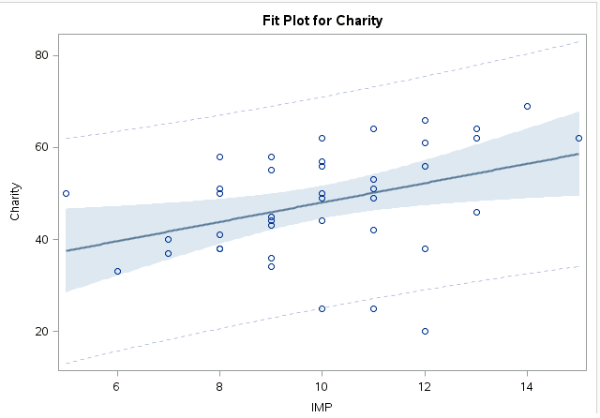
Fit the Model
Cash_C:
0: <= $45,000
1: > $45,000
For low income (Cash_C = 0):
predicted Charity = 48.10 - 0.88 Importance
If Cash_C is left out of the model, Importance alone is significant, but the unique relationship with each income group changes. In other cases, the independent variable could even be insignificant.
For high income (Cash_C = 1):
predicted Charity = 20.42 + 3.27 Importance

Slide 20
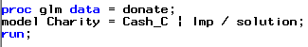
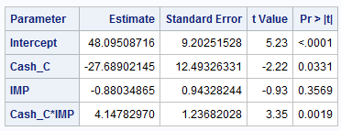
Charity, Cash, and Perceived Importance
Slightly different code—same results
Check the highest order terms first!
0: <= $45,000
1: > $45,000
Include all lower order terms that are included in a significant interaction!
$Predicted Charity= β_{0}+β_{1}Imp+ β_{2}Cash_{C}+ β_{3}Cash_{C}$ $∗Imp$
Predicted Charity = 48.10 - 27.68 Cash_{C} -.88 Imp + 4.15 Cash_{C} *Imp
For low income (Cash_C = 0), predicted Charity = 48.10 - 0.88 Importance
For high income (Cash_C = 1), predicted Charity = 20.41 + 3.27 Importance

Slide 21
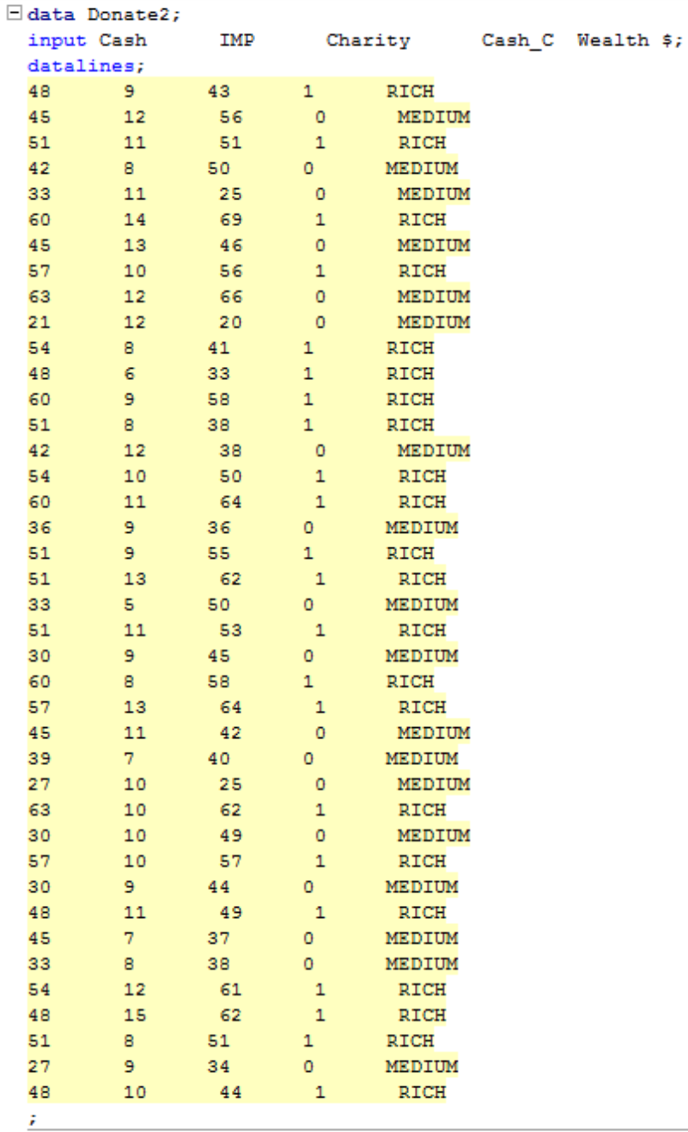
Charity, cash (dichotomous) and Perceived Importance: Recoded!

Slide 22
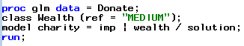
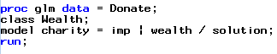
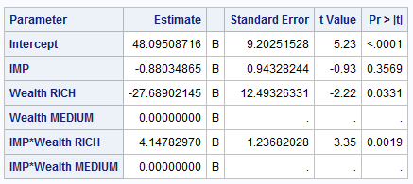

Charity and Perceived Importance: Easier Read and Interpretation
$$Pred Charity= β_{0}+β_{1}Imp+ β_{2}Cash_{C}+ β_{3}Cash_{C}∗Imp$$
Depending on which value is chosen as the reference (rich or medium), the betas will be different but the individual regression equations will be the same. (Try it!)
Remember to Include All Terms that are included in an interaction!
Predicted (Charity |Wealth = Medium) = 48.09 -0.88 Importance
Predicted (Charity | Wealth = Rich) = 20.41 + 3.27 Importance

Slide 23


Charity and Perceived Importance: Easier Read and Interpretation
Wealth is still a dichotomous variable. SAS will treat it like an indicator variable.
$$Predicted Charity= β_{0}+β_{1}Imp+ β_{2}Cash_{C}+ β_{3}Imp∗Cash_{C}$$
Predicted Charity = 48.10 - 0.88 Importance
Predicted Charity = 20.41 + 3.27 Importance
A wealthy individual is predicted to donate on average $27.69 less than a person of medium wealth when the importance of the charity is negligible (p-value = .0331).
However, this is not practical. The important inference is that for each unit of importance more a wealthy person feels the charity is, he or she will on average donate $4.14 more than a person of medium wealth (p-value = 0.0019). A 95% confidence interval for this estimate is ($1.64, $6.66).

Slide 24
Practice!!!
The Exercise 8.26 data set contains the mass (in kilograms), average basal metabolic rate (in kilojoules per day), and lifespan (in years) for 95 mammal species. Is metabolic rate a useful predictor of lifespan after accounting for the effect of body mass? Describe the dependence of the distribution of lifespan on metabolic rate for species of similar body mass.

Slide 25





First Step: Plot the Data

Slide 26
Second Step: Construct a Model
Is metabolic rate a useful predictor of lifespan after accounting for the effect of body mass? Describe the dependence of the distribution of lifespan on metabolic rate for species of similar body mass.
$$pred \log\left(life\right)= β_{0}+β_{1}log⁡(metab)+β_{2}log⁡(mass)$$
No interaction term right now as we are simply putting mass in the model in order to adjust for its effects.

Slide 27


Third Step: Fit the Model
Is metabolic rate a useful predictor of lifespan after accounting for the effect of body mass? Describe the dependence of the distribution of lifespan on metabolic rate for species of similar body mass.
Pred $\log\left(life\right)= β_{0}+β_{1}log⁡(metab)+β_{2}log⁡(mass)$
$$Pred log\left(life\right)=3.72−0.316log⁡(metab)+0.535log⁡(mass)$$
Both terms are significant so we leave both terms in the model.

Slide 28



Fourth Step: Check the Assumptions
$$Pred log\left(life\right)=3.72−0.316log⁡(metab)+0.535log⁡(mass)$$
Normality:
Judging from scatter plot, q-q plot, and histogram of residuals, there is some right skew but not strong enough evidence against normality.
Linear Trend:
It is tough to check linearity in multiple dimensions, although checking pairwise scatter plots indicates a strong linear trend between each log(Exp. Var.) and log(life).
Equal SD:
There is little evidence from the scatter plots of heteroscedasticity.
Independence:
We will assume the observations are independent.

Slide 29

Fifth Step: Interpret
Is metabolic rate a useful predictor of lifespan after accounting for the effect of body mass? Describe the dependence of the distribution of lifespan on metabolic rate for species of similar body mass.
$$Pred log\left(life\right)=3.72−0.316log⁡(metab)+0.535log⁡(mass)$$
A convenient change in Metabolism is a 10-fold increase. Holding body mass constant, it is estimated that a 10-fold increase in metabolism is associated with a (10^{-.31610} = 0.48) 52% decrease in the median Life Span of these 95 mammal species (p-value = 0.0004). A 95% confidence interval for the multiplicative decrease is (10^{-.48607},10^{-.14614}) = (.33,.71) which equates to an estimated decrease between 29% and 67%.

Slide 30






Interpretation Log-Log, Log Model
$$μ\left\{\log\left(Y\right) | \log\left(X_{1}\right),\log\left(X_{2}\right)\right\}=β_{0}+β_{1}\log\left(X_{1}\right)+β_{2}\log\left(X_{2}\right)$$
$$\log\left(Median\left(Y | \log\left(X_{1}\right),\log\left(X_{2}\right)\right)\right)=β_{0}+β_{1}\log\left(X_{1}\right)+β_{2}\log\left(X_{2}\right)$$
$$∗\log\left(Median\left(Y\right)\right) =mean\left(\log\left(Y\right)\right)$$
$$e^{\log\left(Median\left(Y | \log\left(X_{1}\right),\log\left(X_{2}\right)\right)\right)}=e^{\left[β_{0}+β_{1}\log\left(X_{1}\right)+β_{2}\log\left(X_{2}\right)\right]}$$
$$Median\left(Y | \log\left(X_{1}\right),\log\left(X_{2}\right)\right)=e^{\left[β_{0}+β_{1}\log\left(X_{1}\right)+β_{2}\log\left(X_{2}\right)\right]}$$
$$and Median\left(Y | \log\left(10X_{1}\right),\log\left(X_{2}\right)\right)=e^{\left[β_{0}+β_{1}\log\left(10X_{1}\right)+β_{2}\log\left(X_{2}\right)\right]}$$
$$\frac{Median\left(Y | \log\left(10X_{1}\right),\log\left(X_{2}\right)\right)}{Median\left(Y | \log\left(X_{1}\right),\log\left(X_{2}\right)\right)}=\frac{e^{\left[β_{0}+β_{1}\log\left(10X_{1}\right)+β_{2}\log\left(X_{2}\right)\right]}}{e^{\left[β_{0}+β_{1}\log\left(X_{1}\right)+β_{2}\log\left(X_{2}\right)\right]}}=\frac{e^{β_{0}}e^{β_{1}\log\left(10X_{1}\right)}e^{β_{2}\log\left(X_{2}\right)}}{e^{β_{0}}e^{β_{1}\log\left(X_{1}\right)}e^{β_{2}\log\left(X_{2}\right)}}$$
$$\frac{Median\left(Y | \log\left(10X_{1}\right),\log\left(X_{2}\right)\right)}{Median\left(Y | \log\left(X_{1}\right),\log\left(X_{2}\right)\right)}=\frac{e^{β_{1}\log\left(10X_{1}\right)}}{e^{β_{1}\log\left(X_{1}\right)}}=e^{\left[β_{1}\log\left(10X_{1}\right)−β_{1}\log\left(X_{1}\right)\right]}$$
$$\frac{Median\left(Y | \log\left(10X_{1}\right),\log\left(X_{2}\right)\right)}{Median\left(Y | \log\left(X_{1}\right),\log\left(X_{2}\right)\right)}=e^{β_{1}\left[\log\left(10X_{1}\right)−\log\left(X_{1}\right)\right]}$$
** Note: We use a base of 10 for ${10}^{β_{1}}$ because x was increased 10-fold. Any base on the log could be used.
$$\frac{Median\left(Y | \log\left(10X_{1}\right),\log\left(X_{2}\right)\right)}{Median\left(Y | \log\left(X_{1}\right),\log\left(X_{2}\right)\right)}=e^{β_{1}\left[\log\left({10X_{1}}/{X_{1}}\right)\right]}$$
$$\frac{Median\left(Y | \log\left(10X_{1}\right),\log\left(X_{2}\right)\right)}{Median\left(Y | \log\left(X_{1}\right),\log\left(X_{2}\right)\right)}=e^{β_{1}\log\left(10\right)}=e^{\log\left({10}^{β_{1}}\right)}$$
$$\frac{Median\left(Y | \log\left(10X_{1}\right),\log\left(X_{2}\right)\right)}{Median\left(Y | \log\left(X_{1}\right),\log\left(X_{2}\right)\right)}={10}^{β_{1}}$$
Interpretation: While keeping X₂ constant, a 10-fold increase of X₁ is associated with a ${10}^{β_{1}}$ multiplicative increase in the median of Y.

Slide 31

Indicator (Dummy) variables
Suppose we have the independent variable color, which can take on the values ‘blue,’ ‘red,’ and ‘green.’
When we plug the values of the independent variables into the regression equation, we obviously can’t do any math with these colors. So, we create indicator variables. If we create the binary variables color1 and color2, we have a unique and complete mapping from color to the set color1 and color2.
Set $color1=\left\{\begin{aligned}1 if color=blue \\ 0 not blue\end{aligned}\right.$ and $color2=\left\{\begin{aligned}1 if color=red \\ 0 not red\end{aligned}\right.$
By default, if color = green, then color1=0 and color2=0.
 | Blue | Red | Green
Color1 | 1 | 0 | 0
Color2 | 0 | 1 | 0
Because the last category will always occur when all of the indicator variables equal 0, we need c-1 indicator variables for c categories.
SAS can automatically create indicator variables from categorical ones.
Rule of thumb: If you can’t assign units to categories with values 1, 2, 3, etc., the variables should be treated as categorical and indicator variables should be created.

Slide 32
Break Out Unit 12

Slide 33
HSB2 Example
We would like to create a model with a categorical variable for socioeconomic status (SES) in order to test if there is a difference in mean science score for changes between SES = 3 to SES = 1 and SES = 3 to SES =2, taking the math score into account. (Assume math is associated with the science score in the same way for each SES. ) Can we quantify these amounts? That is, by how much can we expect the science score to increase or decrease with respect to SES = 3 (make SES = 3 the reference level). Be sure and write out the model statement and check assumptions!
Next, we want to know if and how much the math score is related to the science score after controlling for the reading score. Be sure and write out the model statement and check assumptions!

Slide 34


Influential Points and Assumptions!!!
$$\hat{μ}\text{\{}\text{Science} \text{Score}\text{|}\text{SES}\text{, }\text{Math}\text{\} =}{ β}_{0}+β_{1}SES1+β_{2}SES2+β_{3}Math$$
There do not appear to be any extremely influential points.
Judging from the scatter plot, q-q plot, and histogram of the residuals, there is no evidence that the residuals do not follow a normal distribution with constant variance.
We assume here that the observations are independent, although we do this with caution as they are known to be clustered by school.

Slide 35

Question 1
$$\hat{μ}\text{\{}\text{Science} \text{Score}\text{|}\text{SES}\text{, }\text{Math}\text{\} =}{ β}_{0}+β_{1}SES1+β_{2}SES2+β_{3}Math$$
SES value | SES1 | SES2
1 | 1 | 0
2 | 0 | 1
3 | 0 | 0
SES = 3 precisely when SES1 = 0 and SES2 = 0
SES = 2 precisely when SES1 = 0 and SES2 = 1
SES = 1 precisely when SES1 = 1 and SES2 = 0
$$\hat{μ}\text{\{}\text{Science} \text{Score}\text{|}\text{SES}\text{ , }\text{Math}\text{\}}=19.91−3.316∗SES1 −1.236 SES2+ .633 Math$$
0
0
$\hat{μ}\text{\{}\text{Science} \text{Score}\text{|}\text{SES}\text{ = 3}\text{, }\text{Math}\text{\} }$= 19.91 – 3.316*0- 1.236*0+ .633 * Math
$\hat{μ}\text{\{}\text{Science} \text{Score}\text{|}\text{SES}\text{ = 3}\text{, }\text{Math}\text{\} }$= 19.91 + .633 * Math
0
$\hat{μ}\text{\{}\text{Science} \text{Score}\text{|}\text{SES}\text{ = 2}\text{, }\text{Math}\text{\} }$= 19.91 –3.316*0 - 1.236*1 + .633*Math
$\hat{μ}\text{\{}\text{Science} \text{Score}\text{|}\text{SES}\text{ = 2}\text{, }\text{Math}\text{\} }$= (19.91 –1.236) + .633*Math
$\hat{μ}\text{\{}\text{Science} \text{Score}\text{|}\text{SES}\text{ = 2}\text{, }\text{Math}\text{\} }$= 18.67 + .633*Math
0
$$\hat{μ}\text{\{}\text{Science} \text{Score}\text{|}\text{SES}\text{ = 1}\text{, }\text{Math}\text{\}= 19.91 – 3.316∗1− 1.236∗0+ .633 ∗ }\text{Math}$$
$$\hat{μ}\text{\{}\text{Science} \text{Score}\text{|}\text{SES}\text{ = 1}\text{, }\text{Math}\text{\}= (19.91 – 3.316)+ .633 ∗ }\text{Math}$$
$$\hat{μ}\text{\{}\text{Science} \text{Score}\text{|}\text{SES}\text{ = 1}\text{, }\text{Math}\text{\}= 16.59+ .633 ∗ }\text{Math}$$

Slide 36

Question 1
$$\hat{μ}\text{\{}\text{Science} \text{Score}\text{|}\text{SES}\text{, }\text{Math}\text{\} =}{ β}_{0}+β_{1}SES1+β_{2}SES2+β_{3}Math$$
SES value | SES1 | SES2
1 | 1 | 0
2 | 0 | 1
3 | 0 | 0
$$\hat{μ}\text{\{}\text{Science} \text{Score}\text{|}\text{SES}\text{ , }\text{Math}\text{\}}=19.91−3.316∗SES1 −1.236 SES2+ .633 Math$$
$\hat{μ}\text{\{}\text{Science} \text{Score}\text{|}\text{SES}\text{ = 3}\text{, }\text{Math}\text{\} }$= 19.91 + .633 * Math
$\hat{μ}\text{\{}\text{Science} \text{Score}\text{|}\text{SES}\text{ = 2}\text{, }\text{Math}\text{\} }$= 18.67 + .633*Math
$$\hat{μ}\text{\{}\text{Science} \text{Score}\text{|}\text{SES}\text{ = 1}\text{, }\text{Math}\text{\}= 16.59 + .633∗}\text{Math}$$
95% CI: t_{.975, 200-4}=1.97
3.316+- 1.56*1.97
=3.316+-3.07
=(.24, 6.4)
A change from SES = 3 to SES =2 does not appear to significantly influence the mean science score although a change from SES = 1 to SES = 3 appears to be significant in estimating the mean science score. The best estimate is that a change from SES = 3 to SES = 1 is associated with a 3.316 point decrease in the mean science score. A 95% confidence interval for this decrease is (.24, 6.4) points. In addition, since the slopes are assumed to be identical, this change is assumed to be constant across all math scores. This is an observational study thus only associations can be made. The data could be rerun by grouping SES=3 and SES=2 together, but we will leave it as is here.

Slide 37

Question 1: That is, by how much can we expect the science score to increase or decrease with respect to SES = 3 (make SES = 3 the reference level).

Slide 38
Breakout question 2

Slide 39
HSB2!
We would like to create a model with a categorical variable for socio economic status (SES) in order to test if there is a difference in mean science score for changes between SES = 3 to SES = 1 and SES = 3 to SES =2. Taking the math score into account (assume math is associated with the science score in the same way for each SES. Can we quantify these amounts? That is, by how much can we expect the science score to increase or decrease with respect to SES = 3 (make SES = 3 the reference level). Be sure and write out the model statement and check assumptions!
Next, we want to know if and how much the math score is related to the science score after controlling for the reading score. Be sure and write out the model statement and check assumptions!

Slide 40


Question 2 Influential Points and Assumptions!!!
$$\hat{μ}\text{\{}\text{Science} \text{Score}\text{|}\text{Math}\text{, }\text{Read}\text{\} =}{ β}_{0}+β_{1}Math+β_{2}Read$$
There does appear to be one potential influential point. We should take a closer look at this observation.
Judging from the scatter plot, q-q plot and histogram of the residuals, there is no evidence that the residuals do not follow a normal distribution with constant variance.
We assume here that the observations are independent although we do this with caution as they are known to be clustered by school.

Slide 41



Question 2:
$$\hat{μ}\text{\{}\text{Science} \text{Score}\text{|}\text{Math}\text{\} =}{ β}_{0}+β_{1}Math$$
$$\hat{μ}\text{\{}\text{Science} \text{Score}\text{|}\text{Math}\text{, }\text{Read}\text{\} =}{ β}_{0}+β_{1}Math+β_{2}Read$$
The math score is associated with the mean science score even after the reading score has been accounted for. Holding the reading score constant, a 1 point increase in the math score is associated with a .4 point increase in the mean science score. This is an observational study thus only associations can be made.

Slide 42
Appendix
More examples (including R)

Slide 43

Practice!
On 2DS, there is a dataset called “interact.”
Construct a Model in which the mean of y linearly depends on x and the gender. In addition, enable the to model to detect the possibility that the slope depends on the gender.
Fit this model using SAS.
Produce a coded scatter plot of the data.
Write the equation of each line of the plot. (y=mx+b form)

Slide 44




Practice!!!
$$\hat{y}= β_{0}+β_{1}x+ β_{2}Gender+ β_{3}(x∗Gender)$$
$$\hat{y}=2.8+1.7x+7.15Gender+4.15(x∗Gender)$$
$$\hat{y}=2.8+1.7x :MALE$$
$$\hat{y}=9.95+5.85x:FEMALE$$

Slide 45



Example!

Slide 46



The Fit
$$pred Heart= β_{0}+β_{1}Bank+ β_{2}Walk+ β_{3}Talk$$
Use alpha = 0.1.
Refit without Talk (p-value = 0.4249).
$$pred Heart= β_{0}+β_{1}Bank+ β_{2}Walk$$
$$pred Heart=2.05+.349Bank+ .399Walk$$
Holding the bank time fixed, each additional second recorded in the walking speed variable is associated with an increase of .399 deaths to the city’s mean death rate.
Holding the walking speed fixed, each additional second recorded in the time it takes to make change for two $20 bills is associated with an increase of .349 deaths to the city’s mean death rate.

Slide 47


A Comparison of Y-Intercepts

Slide 48


A Comparison of Y-Intercepts (Type Doesn’t Matter)

Slide 49


A Comparison of Y-Intercepts

Slide 50
R GGPLOT2
Dataset
X and Y
This actually adds the points to the plot.
This fits and plots the regression line.

Slide 51
R GGPLOT2
Dataset
X and Y
This identifies the two groups to plot a fit.
This actually adds the points to the plot.
This fits and plots the regression line.

Slide 52




But back to the question! A Comparison of Y-Intercepts

Slide 53
Hypothesis Test of the Categorical Variable
This is an estimate of the Type A intercept.
This is an estimate of the DIFFERENCE between the Type A and Type B Intercepts.
It is NOT significantly different from 0. (p-value = .666)

Slide 54
Hypothesis Test of the Categorical Variable
{
{
9.93
This is an estimate of the Type A intercept.
9.93
Since the lines are parallel.
This is an estimate of the DIFFERENCE between the Type A and Type B Intercepts.
Type B’s Intercept is estimated to be 9.93 units bigger than Type A’s intercept.
Type B’s Estimated Intercept = 50.27 + 9.93 = 60.20 units

Slide 55

Hypothesis Test of the Categorical Variable
$$Type A: \hat{Y}=50.27+2.99X$$
$$Type B: \hat{Y}=\left(50.27+9.93\right)+2.99X=60.20+2.99X$$

Slide 56




Categorical Variables in MLR … Different Intercepts!
$$Model: μ\text{\{}Y | \text{X}\text{, }\text{Type}\text{ = 0\} =}{ β}_{0}+β_{1}X+β_{2}Type$$
$$μ\text{\{}Y | \text{X}\text{, }\text{Type}\text{ = 0\} =}{ β}_{0}+β_{1}X$$
Type = 0 for A
$$μ\text{\{}Y | \text{X}\text{, }\text{Type}\text{ = 0\} = }{(β}_{0})+β_{1}X$$
Type = 1 for B
$$μ\text{\{}Y | \text{X}\text{, }\text{Type}\text{ = 1\} = }β_{0}+β_{1}X+β_{2}$$
This makes ’A’ the “Reference.”
$$μ\text{\{}Y | \text{X}\text{, }\text{Type}\text{ = 1\} = }{(β}_{0}+β_{2})+β_{1}X$$
Note 1: $β_{2}$ is the adjustment to Type A’s intercept to get Type B’s Intercept.
Note 2: $β_{1}$ is the slope for both lines. They are parallel.

Slide 57



Categorical Variables in MLR … Different Slopes! Think INTERACTION
$Model: μ\text{\{}Y | \text{X}\text{, }\text{Type}\text{ = 0\} =}{ β}_{0}+β_{1}X+β_{2}Type$ $+β_{3}Type∗X$
$$μ\text{\{}Y | \text{X}\text{, }\text{Type}\text{ = 0\} =}{ β}_{0}+β_{1}X$$
Type = 0 for A
$$μ\text{\{}Y | \text{X}\text{, }\text{Type}\text{ = 0\} = }{(β}_{0})+β_{1}X$$
Type = 1 for B
$$μ\text{\{}Y | \text{X}\text{, }\text{Type}\text{ = 1\} = }β_{0}+β_{1}X+β_{2}+β_{3}X$$
This makes ’A’ the “Reference.”
$$μ\text{\{}Y \left| \text{X}\text{, }\text{Type}\text{ = 1\} = }{(β}_{0}+β_{2}\right)+β_{1}X+β_{3}X$$
$$μ\text{\{}Y \left| \text{X}\text{, }\text{Type}\text{ = 1\} = }{(β}_{0}+β_{2}\right)+{(β}_{1}+β_{3})X$$
Note 1: $β_{2}$ is the adjustment to Type A’s intercept to get Type B’s Intercept.
Note 2: $β_{3}$ is the adjustment to Type A’s slope to get Type B’s Slope!
They are not forced to be parallel!

Slide 58

A Comparison of Slopes!
There is clear visual evidence of different slopes and different y-intercepts. Let’s fit a model that allows the flexibility to reflect this.

Slide 59




A Comparison of Slopes!
$$Type A: \hat{Y}=5.8140+4.03X$$
$$Type B: \hat{Y}=(5.81+14.78)+(4.03+(−7.19))X$$
$$Type B: \hat{Y}=20.59−3.16X$$

Slide 60
What do we think about these from before? Different Slopes?

Slide 61

What do we think about these from before? Different Slopes?

Slide 62



What do we think about these from before? Different Slopes?
$$Type A: \hat{Y}=−.18+3.06X$$
$$Type B: \hat{Y}=−.18+3.06X$$

Slide 63

What do we think about these from before? Different Slopes?
$$Type A: \hat{Y}=50.27+2.99X$$
$$Type B: \hat{Y}=\left(50.27+9.93\right)+2.99X=60.20+2.99X$$

Slide 64




Meadowfoam: Intensity Only
$$\hat{μ}\text{\{}\text{flowers}\text{|}Intensity\text{\} = }β_{0}+β_{1}Intensity$$

Slide 65


Meadowfoam: Light Intensity and Time
$\hat{μ}\text{\{}\text{flowers}\text{|}\text{Intensity}\text{\} = }β_{0}+β_{1}Intensity+β_{2}time$ $+β_{3}Intensity∗time$

Slide 66




Meadowfoam: Light Intensity and Time
Intercept = 83.46
(Note that chart y-int is off the left end of the chart.
$$\hat{μ}\text{\{}\text{flowers}\text{|}\text{Intensity}\text{\} = }β_{0}+β_{1}Intensity+β_{2}time$$
Intercept = 83.45417 + (- 12.15833)
= 71.3
Slopes = -.04047
$$\hat{μ}\text{\{}\text{flowers}\text{|}\text{light}\text{,}\text{time}\text{ = }\text{Late}\text{\} = }71.3+\left(−.0405\right)Intensity$$
$$\hat{μ}\text{\{}\text{flowers}\text{|}\text{light}\text{,}\text{time}\text{ = }\text{Early}\text{\} = }83.46+\left(−.0405\right)Intensity$$

Slide 67


Meadowfoam: Intensity and Timing
$$\hat{μ}\text{\{}\text{flowers}\text{|}Intensity\text{\} = }β_{0}+β_{1}Intensity+β_{2}timing$$
There do not appear to be any extremely influential points. Judging from the scatter plot, qq plot and histogram of the residuals, there is no evidence that the residuals do not follow a normal distribution with constant variance.

Slide 68

Meadowfoam: Conclusion
Increasing Intensity decreased the mean number of flowers per plant by an estimated 4.0 flowers per plant per 100 nano mol / m2 / sec. (95% confidence interval from 3.0 to 5.1) Beginning the light treatment 24 days before PFI (timing = Early) increased the mean number of flowers per plant by an estimated 12.2 flowers (95% confidence interval from 6.7 to 17.6) We can draw the above causal relationship since the seeds were randomly assigned to each treatment group. Since we have assumed equal slope we can assume this difference is consistent across all intensities (not just at the intensity = 0 (the y-int)).

Slide 69


Example Where Interaction Matters
This is a data set that records the amount of cash some one makes (Cash) and the amount of money they give to Charity (Charity) based on the Importance (Importance) each subject attributes to the charity. Wealth is a variable that indicates if the person makes over $45,000 (Rich) or $45,000 or less (Medium).

Slide 70
Example Where Interaction Matters
Construct a multiple linear regression model in which the mean charitable donation depends on (linearly) the importance of the charity and both income groups. Allow for possible different slopes and intercepts.
$$Charity= β_{0}+β_{1}Importance+ β_{2}Wealth+ β_{3}Importance∗Wealth$$

Slide 71


Charity and Perceived Importance: Fit the Model
Pred $Charity= β_{0}+β_{1}Importance+ β_{2}Weatlh+ β_{3}Importance∗Wealth$

Slide 72


Check the Residuals

Slide 73
Fit the Model
Remember to Include All Terms that are included in an interaction!
$$pred Charity= β_{0}+β_{1}Importance+ β_{2}Wealth+ β_{3}Importance∗Wealth$$
Pred Charity = 48.10 - 27.68 Cash -.8803 Imp + 4.15 Cash *Imp
Pred Charity = (48.10 - 27.68 Cash) + (-.8803 + 4.15 Cash) Imp
Medium: <= $45,000
Rich: > $45,000
Pred Charity = 48.09 + (- 0.88) Importance
Pred Charity = 20.41 + 3.27Importance

Slide 74

Conclusion
Medium: <= $45,000
Rich: > $45,000
Pred Charity = 48.09 + (- 0.88) Importance
Pred Charity = 20.41 + 3.27 Importance
For Wealthy donors, it is estimated that for every 1 additional point increase in importance, the amount they will donate to charity increases $3.27. For donors of Medium wealth, there is not significant evidence to suggest that the level of importance is a factor in the amount they will donate (p-value = .3569 ).

